Slide 1
INDUSTRY Lab: Presentation to MCKinsey & Company
Market Sentiment Group
Dhiren Bhatia, Robert (I-Hsiang) Chang, Zach Travis, Daisy Zhe Wang

Slide 2
Example

Slide 3
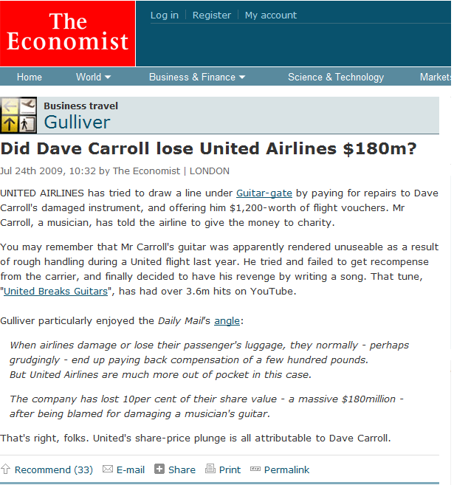
Example

Slide 4
INDUSTRY Lab: Presentation to MCKinsey & Company
Part I : Introduction
Dhiren Bhatia, Robert (I-Hsiang) Chang, Zach Travis, Daisy Zhe Wang

Slide 5

Executive Summary
Executive Summary:
The prospect of sentiment analysis lies in the ability to:
Access and process sentiments from across the internet
Aggregate subjective opinions into organized, meaningful, timely data
This will provide a measurable competitive edge to decision makers.

Slide 6
Prospect of Sentiment Analysis
Prospects of Sentiment Analysis:
 | Marketing | Customer Support | Crisis Management
Past | Paper Survey Focus group | Call center Walk-ins | Ad-hoc Non scientific
Present | Electronic surveys Questionnaires | eService Online chat | Scientific But often delayed
Future | Voluntary reviews. Real time monitoring | Reach out to customers Participate in discussion | Scientific Active, More anticiaption

Slide 7
Economic Impact of Sentiment Analysis
Economic impact as measured using buyer/seller data on auction sites such as Ebay and Amazon.com
Sellers with more than 675 positive comments earned a premium of $45.76, more than 10% of the mean selling price, as compared to new sellers with no feedback
At the negative end, that a move from 2 to 3 negatives cuts the price by 11%, about $19 from a mean price of $173.
On average,
3.46 percent of sales is attributable to the seller’s positive reputation stock
The average cost to sellers stemming from neutral or negative reputation scores is $2.28, or 0.93 percent of the final sales price
Extrapolating this data on eBay’s total annual auction sales,
Sellers’ positive reputations added more than $220 million to the value of sales
Non-positives reduced sales by about $60 million

Slide 8
INDUSTRY Lab: Presentation to MCKinsey & Company
Part II : CET Research
Dhiren Bhatia, Robert (I-Hsiang) Chang, Zach Travis, Daisy Zhe Wang

Slide 9
Two Important Criteria
Two Important Criteria:
A good sentiment analysis technology automates measurement of customer sentiment and tracks customer satisfaction, guiding executive decisions for future investments and corrective changes. A sentiment analysis tool should have:
The ability to accurately identify user sentiment, including subtleties of human language
Supervised learning
Unsupervised learning
The ability to consolidate and analyze sentiment data from different sources: news, blogs, customer reviews, etc…
Topic dependence
Domain dependence
Temporal dependence
Language dependence

Slide 10
CET Research
Data Collection and Labeling:
Scraped user-generated content:
Hotel reviews of Marriott and competitors from TripAdvisor.com
Textual issues:
Misspellings, slang, malformed entries, foreign languages…
Differentiating sentiments from facts
Citation/quotation, debate/discourse
The order of the opinions presented

Slide 11
CET Research
Examples:
“Great spot 8th October 2005, 1 night.”
“Stay in hotels 20-30nights a year: Stayed here twice Nont Impressed Other options should be considered if staying downtown.”
4.0
2.0
“I recently stayed at the Mobile Marriott on a business trip. Being my first time in Mobile, I did not know what to expect of the hotel or the city. With a little hesitation, I booked the Mobile Marriott due to the its location alone (it is right on Airport Boulevard next to the interstate and in the middle of everything). On my arrival, I was met with the usual smile, however the agent actually shook my hand, thanked me for selecting their hotel, and on finding out it was my first time in Mobile, he took the time to suggest some places and dining options for me to visit while I was there. This all sounds great for a small quiet hotel, but the hotel was packed for the GMAC bowl (I even scored some tickets). The room was nice, not modernized but comfortable and clean - the most important thing I look for. I dined in their restuarant and had room service during my stay - both were good. Served quickly and cooked to order. The one thing that really stands out at this hotel is that the staff are genuinely friendly. Every person I encountered took a moment to recognize me. When I stood in the lobby, they approached me to talk. I really was made to feel special, for lack of a better word. I would definitely come back to the Mobile Marriott and have recommended it to my colleagues, two of which it turns out will only stay at this hotel as well. As for Mobile, its a nice city - nicer than I anticipated. While no one looks forward to life on the road, I have no hesitations about returning to this city and hotel."
5.0

Slide 12


CET Research
Bag-of-Words Model (I) – Learning
Training Documents
Sentences
Marriott is
a great hotel. (+)
Marriott is
a great hotel. (+)
......
We hate it. (-)
1. Extract
Sentences
2. Extract
Bag-of-Words
…...
a
We hate it. (-)
great
hate
it
Marriott
3. Extract Feature
Vectors
hotel
is
We
Naïve Bayes
Classifier
Feature Vector
Positive/
Negative
4.Learn Multinomial
Naïve Bayes Model
a
great
…...
is
we

Slide 13
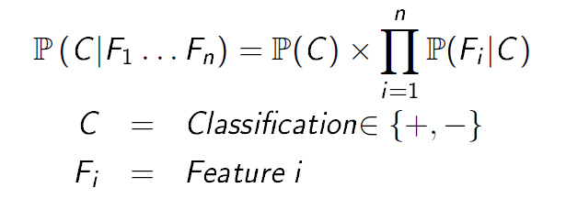
CET Research
Naïve Bayes Classifier:
A Bayes classifier is a simple probabilistic classifier based on applying Bayes’ Theorem.
Positive
Negative
a
great
…...
is
we
no
hate
…...
a
the
.2
.7
.2
.1
.2
.7
.2
.1

Slide 14
CET Research
Bag-of-Words Model (II) – Inference
New Documents
Sentences
New Documents
1. Extract
Sentences
Marriott is
a great hotel.
Feature Vector
Marriot has
good service.
…….
We love it.
Bag-of-Words
a
great
it
hate
2. Extract Feature
Vectors
Marriott
hotel
is
We
3. Infer the Sentiment
on new documents
Naïve Bayes
Classifier
Positive/
Negative
Marriot has
good service. (+)
…….
We love it. (+)
a
great
…...
is
we
.2
.7
.2
.1

Slide 15
CET Research
Dictionary Model:
Same Learning-Inference process
Replace Bag-of-Words with Sentiment Dictionary
More human effort but more accurate!
80%+ accuracy for the dictionary model
Can reach 90%+ with more engineering:
Handling negative tones, entity association, sarcasm, ...
Part-of-speech tagging, Named Entity Recognition, Co-reference, …

Slide 16
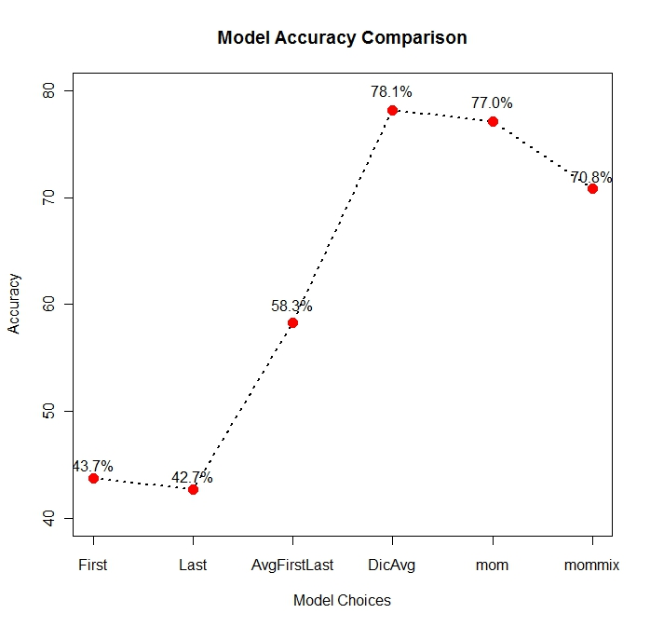
CET Research
Model Comparison:

Slide 17
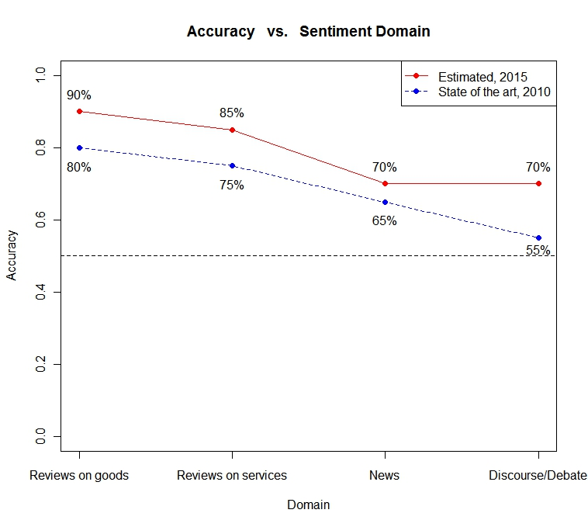
CET Research
Data Complexity:
Business Applications

Slide 18
INDUSTRY Lab: Presentation to MCKinsey & Company
Part III : Sentiment Aggregation
Dhiren Bhatia, Robert (-Hsiang) Chang, Zach Travis, Daisy Zhe Wang

Slide 19
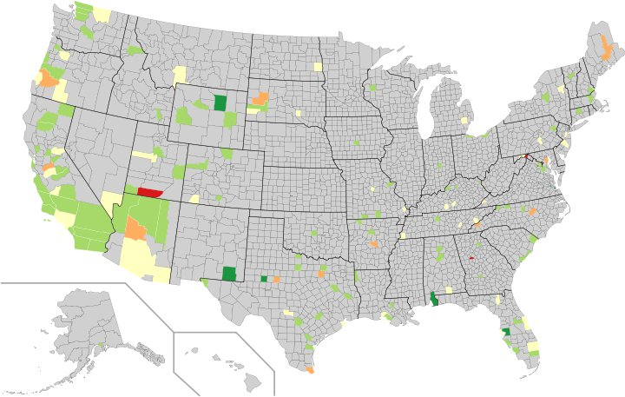
Sentiment Aggregation
Sentiment Dashboard: Heat Map
5 (Good)
4
3
2
1(Bad)

Slide 20
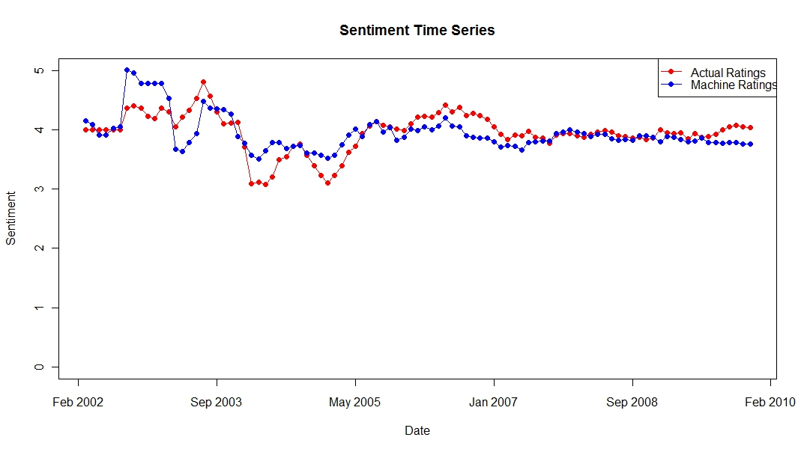
Sentiment Aggregation
Sentiment Dashboard: Time Series

Slide 21
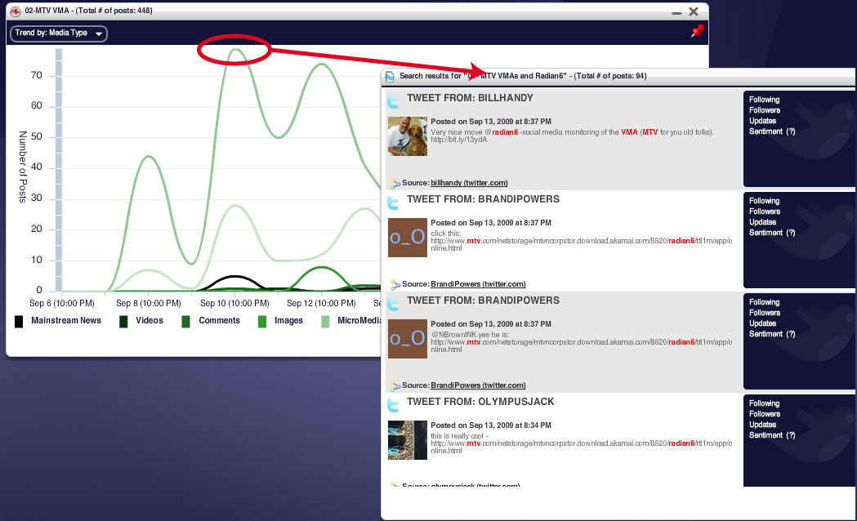
Sentiment Aggregation
Sentiment Dashboard: Drill Down
Source: Radian6

Slide 22
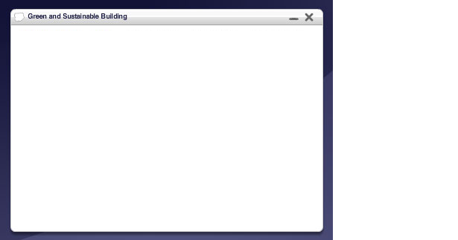
Sentiment aggregation
Sentiment Dashboard: Word Cloud
Marriott Word Cloud
staff
Service
Pool
Bed
Front Desk
Bathroom
Breakfast
clean
Price
Noise
Lobby
Buffet
Parking
Size = Frequency of the word
Color = Red (Negative), Green (Positive)

Slide 23
Conclusion
Conclusion:
Explosion of social media and emergence of new online social activity
Reputation and brand Image have profound economic impact on consumer purchasing behaviors
New business opportunities!
Sentiment Analysis Technology can enable automatic and active monitoring of sentiment as word of mouth develops
What can we offer? A tool with different dash-boards to track different entities and different data sources with drill down and statistics
Ultimately, businesses that develop novel ways of using the technology will gain enormous business advantage.

